Slide 1
AUTOMOTIVE SAFETY SYSTEMS
PROJECT REVIEW 1

Slide 2
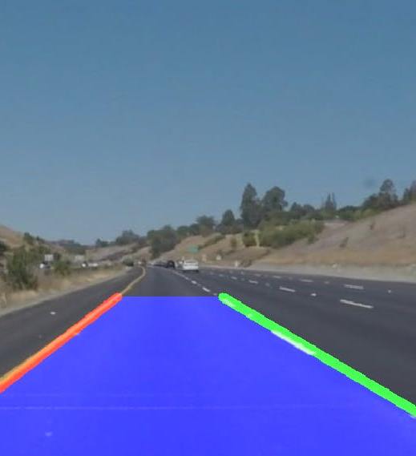
PROJECT TITLE
LANE DETECTION USING PYTHON

Slide 3

TEAM MEMBERS
AARSHA MITHRA VAVILALA -19BMA0035
YANDRA MURALI MANOHAR - 19BMA0003
MEET BHANUSHALI - 19BMA0061

Slide 4
Abstract
Identifying lanes on the road is a common task performed by all human drivers to ensure their vehicles are within lane constraints when driving, so as to make sure traffic is smooth and minimise chances of collisions with other cars in nearby lanes. Similarly, it is a critical task for an autonomous vehicle to perform.Autonomous Vehicles are using Comuter vision based systems for this as a part of Localisation and being used in autonomous vehicles starting from Level 1(Based on 5 levels of Autonomy).In this project we will be using Computer Vision techniques to perform the same.

Slide 5
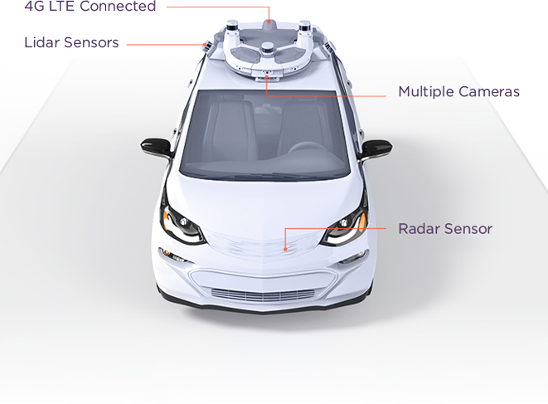
Camera Module mounted on the vehicle.

Slide 6
OBJECTIVES
To detect lanes on roads using a monocular camera
setup in several ODD.
To find the central offset of the vehicle.

Slide 7
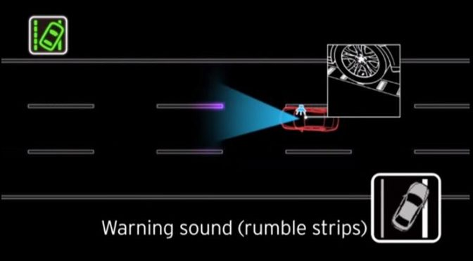
Lane departure crashes
Lane departure crashes occur when a vehicle drifts out of its lane and either runs off the road to the right or moves into the path of oncoming traffic to the left. While lane departure accidents are usually attributed to driver error, there are a number of reasons why a car might drift. Lane detection system keeps traqck on the lane marks and helps minimize these accidents.

Slide 8
APPLICATIONS
DRIVER ASSISTANCE
LANE DEPARTURE WARNING
LANE KEEPING SYSTEMS

Slide 9
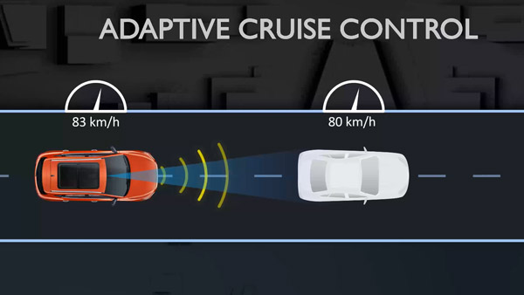
ACC uses Lane Keeping in additon to several other sensors

Slide 10
THANK YOU

